Slide 1

Website analysis & prototyping
Los Cobras

Slide 2
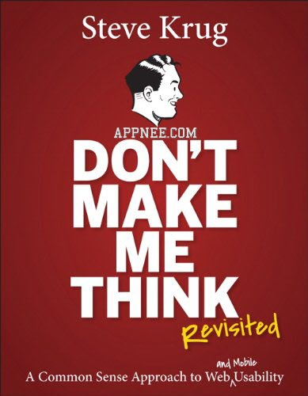
Reading: Don't Make Me Think
Chapters 10, 11 & 12

Slide 3
GLOSSARY
Constraints: Things you have to do and things you can’t do.
Meme:
1 : an idea, belief or belief system, or pattern of behavior that spreads throughout a culture either vertically by cultural inheritance (as by parents to children) or horizontally by cultural acquisition (as by peers, information media, and entertainment media) Etc.
Responsiveness
As a concept of computer science refers to the specific ability of a system or functional unit to complete assigned tasks within a given time.
Tradeoff: The exchange of one thing for another of equal value.
CECILIA

Slide 4
GLOSSARY
Apps: A App is an application of software that one installs in mobile devices or tablets
multi-finger: Is a technology that enables a surface to recognize the presence of more than one, or more than two points of contact with the surface.
Stakeholders: The term groups workers, social organizations, shareholders and suppliers, between many other key actors who meet affected by the decisions of a company.
Testing: The testing is defined as a technical investigation of a low product tries in order to offer information relative to the quality of the software, to the different actors involved in a project.
ANTONIO

Slide 5
GLOSSARY
Affordances: Intuitive understanding (or property from obvious part of the object on which we perform the action and how) is a principle known as affordance and constitutes a basic concept of vital importance in the design of any type of interface.
Efforts: Action to use great physical or moral force any particular purpose.
Madness: Pathological disorder or disruption of mental faculties.
Revenue: Income Amount of money earned or collected.
Willing: Voluntary, compliant. That aims to please or satisfy the desires of someone.
EDUARDO

Slide 6
GLOSSARY
Closed Caption (CC): Captions are transcription or translation of the dialogue, sound effects, relevant musical cues, and other relevant audio information ... when sound is unavailable or not clearly audible (for example, when audio is muted or the viewer is deaf or hard of hearing).
Screen-reader: A screen reader is a software application which, rather than presenting web content visually, converts text into 'synthesised speech' allowing user to alternatively listen to content.
User Experience (UX): Is a person's entire experience using a particular product, system or service. It includes the practical, experiential, affective, meaningful and valuable aspects of human-computer interaction and product ownership.
Web Content Accessibility Guidelines (WCAG): Web Content Accessibility Guidelines (WCAG) is developed through the W3C process in cooperation with individuals and organizations around the world, with a goal of proving a single shared standard for web content accessibility that meets the needs of individuals, organizations, and governments internationally.
Web Template: A website template is a predesigned resource that shows the structure for the comprehensive layout and display features of any website. It is provided by various suppliers to help make Web design a lot easier for designers.
JULIO

Slide 7
Glossary
Printer-friendly :Is a term used on the Internet to describe a version of a web page formatted for printing
Shucking and jiving: Is a term for the behavior of joking and acting evasively
Sole Source: One and only one source that possesses a unique product having singular characteristics or performance capabilities
Technical support: Refers to services by which enterprises provide assistance to users of technology products such as phones, computers, software products or other informatic, electronic or mechanical goods.
VLADISLAV

Slide 8
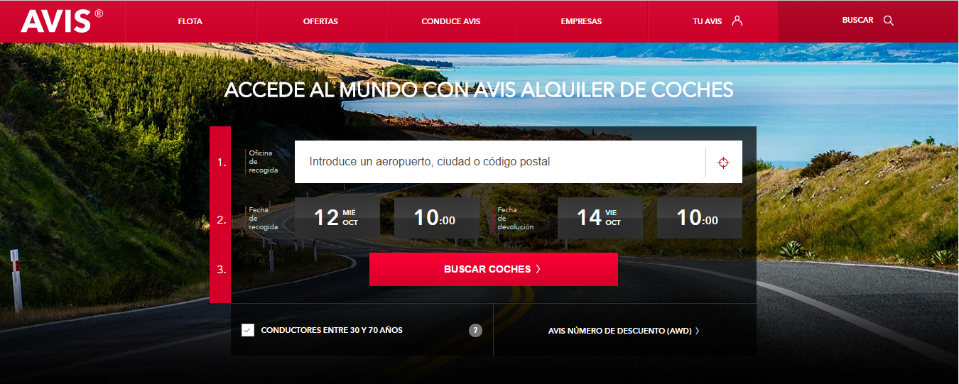
Website analysis www.avis.es

Slide 9
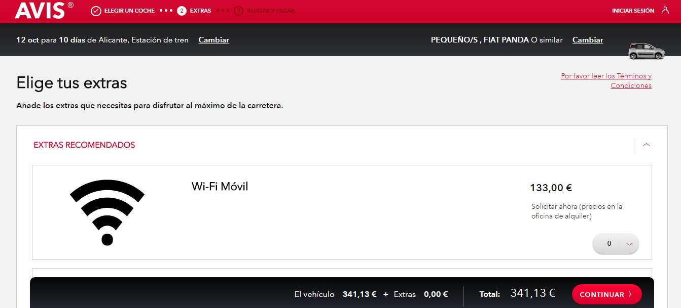
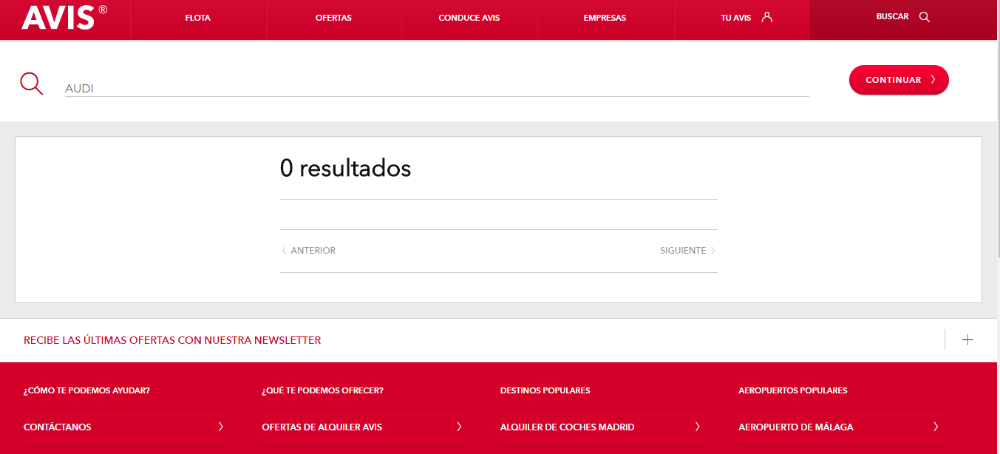
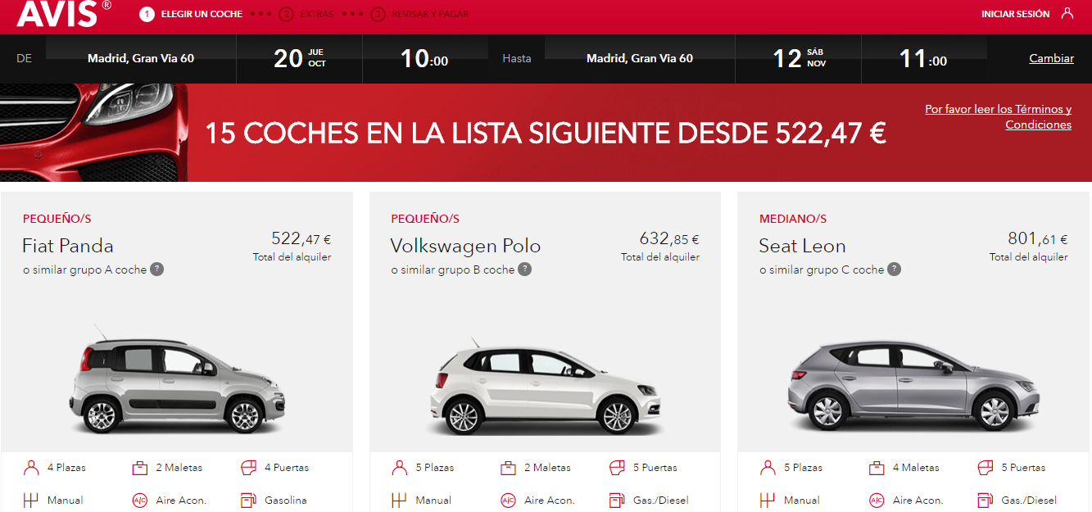
Website analysis www.avis.es

Slide 10
Website analysis www.avis.es
What site is this? (Is it clear enough?)
The page you have to analyze is to rent cars. It is very clear and detailed
Does it follow conventions?
Menus, logos, content,…
Yes it does. The web site developments did an in-depth work. For example: when you do 2 and 3 tabs, two hidden links appears. Even they are using WAI-ARIA statements
*WAI-ARIA, the Accessible Rich Internet Applications Suite, defines a way to make Web content and Web applications more accessible to people with disabilities. It especially helps with dynamic content and advanced user interface controls developed with Ajax, HTML, JavaScript, and related technologies
Are elements clear enough? (Search inputs, icons, social networks,…)
In the same home page has a search engine. As well as its menu header to make it accessible from any page or sublevel. It has few icons: save the company and icons belonging to the social networks thar are often almost as footnotes.

Slide 11
Website analysis www.avis.es
Is the hierarchy evident (sections, subsections,…)? Can I see the major sections of the site? What options do I have at this level of the hierarchy?
Yes, you have de navegation bar in the home page with the first level and, if you click in one of them, you will go to the second level
Are the pages divided in well defined sections / layers?
Yes. They have a header with a main menu. And depending on where we are page will have a submenu. And then the content. Followed by advertising and promotions and other general information section of the Company

Slide 12
Website analysis www.avis.es
Can you distinguish links and buttons?
Yes, the buttons have a distinctive color with a 3D form
Is there any content that distracts the user?
Yes, a floating chat bar in the left side.
Is the content structured?
Yes, there is the head, where you can find the different sections, the body where shows the content and in the bottom the page the site you can see FAQs, contact links, privacy politics etc.
Are there any search options? Are they clear enough?
The website has a search engine. It is present in the top menu. By testing, I tried to find something and found nothing.

Slide 13
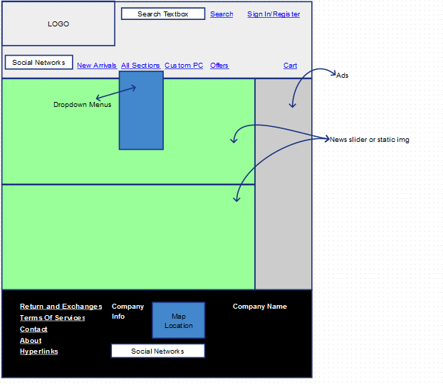
Prototyping

Slide 14
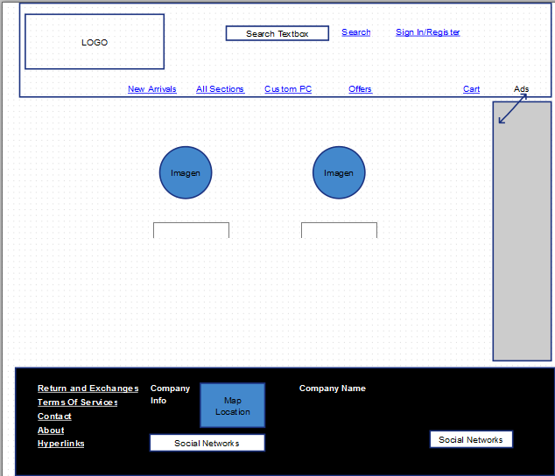
LEVEL 1

Slide 15
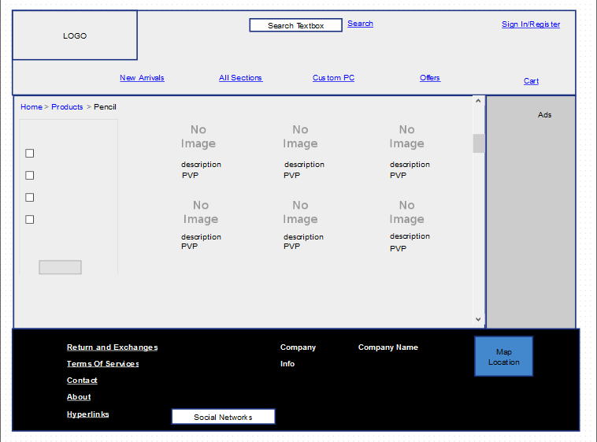
Second level

Slide 16
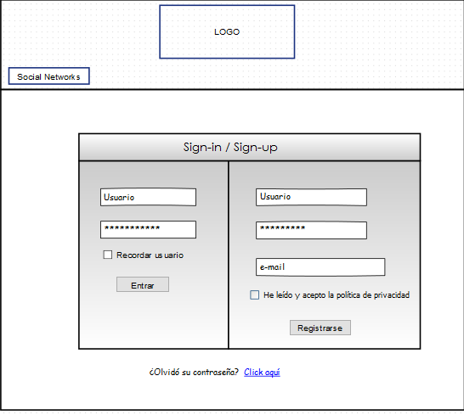
LOGIN / REGISTER

Slide 17
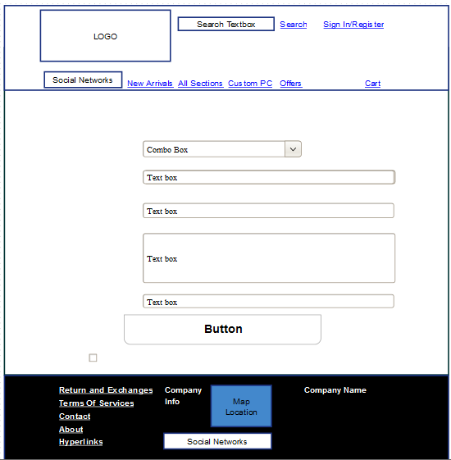
CONTACT

Slide 18
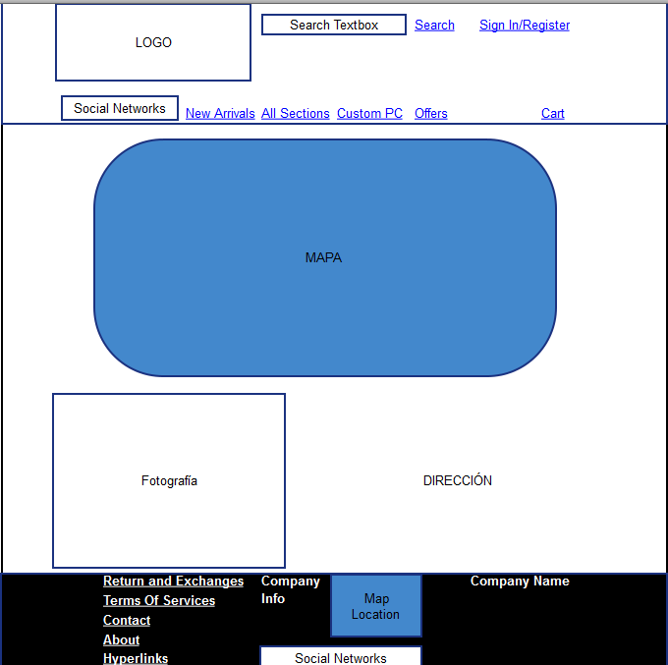
LOCATION

Slide 19
HTML Layout with PUG
https://github.com/interfacesweb16-17/s1_cobras

